Slide 1


HV Tower Monitoring
Failure detection with Faster R-CNN

Slide 2
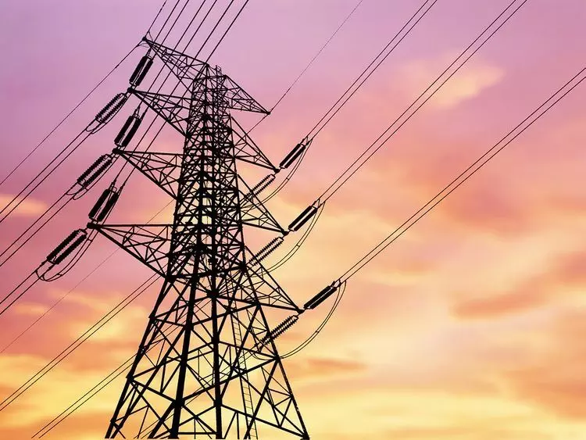
Agenda
1
Business Understanding
2
Data Understanding
3
Data Preparation
4
Modeling
5
Evaluation
6
Demo
7
Lessons Learned

Slide 3
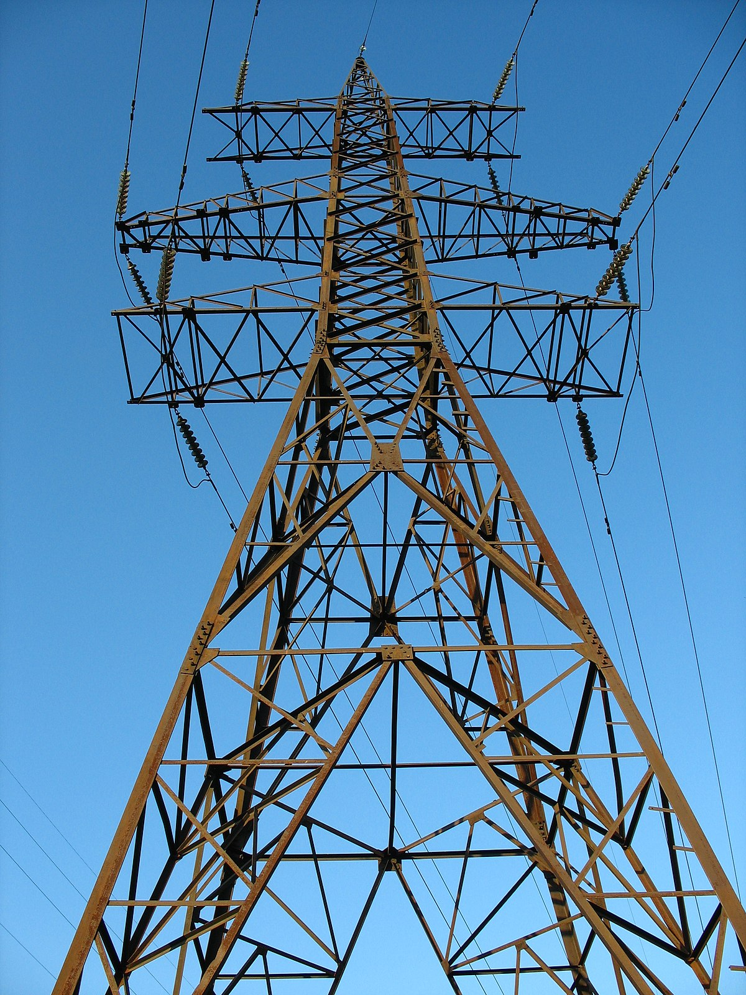
1. Business understanding
Objective:
Develop a computer vision model to detect rust or corrosion on drone-captured images of towers.
Goals:
Automate the detection of corrosion to improve maintenance efficiency.
Provide health index for each tower based on the severity of detected rust.
Enable data-driven decision-making for tower maintenance.
Business Needs:
Reduce manual inspection time and labor costs associated with tower maintenance.
Enhance the accuracy and reliability of corrosion detection.
Minimize maintenance costs by timely identifying towers that need repairs.
Improve safety by preventing structural failures due to undetected corrosion.

Slide 4
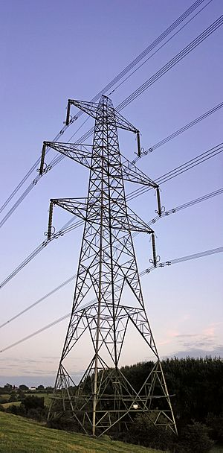
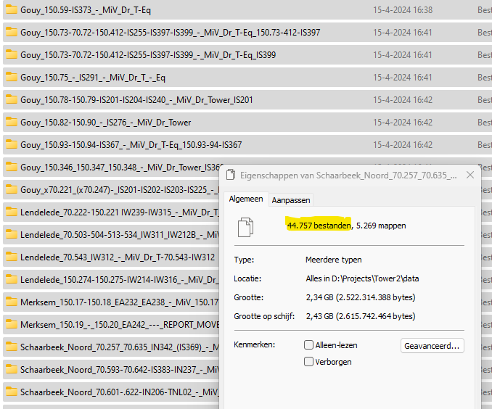
2. Data Understanding
Data Collection:
Source: High-resolution images captured by drones of various towers.
Types of Data:
Image Data: Photos of towers showing varying levels of corrosion.
Metadata: Information about the images such as location, bounding boxes and labels.
Volume: Large dataset comprising thousands of images collected from multiple inspections over time.

Slide 5
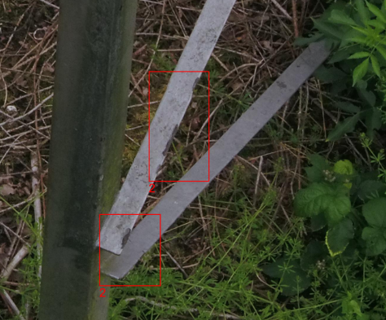
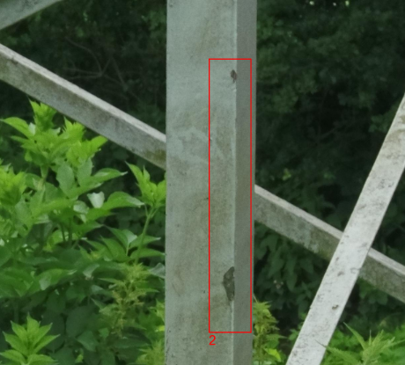
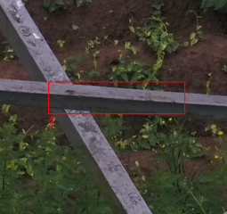
1. Data Preparation
Data Labeling:
Initial Annotations: The images were initially annotated by an AI program from an external company. These annotations were found to be imprecise and not completely correct.
Manual Corrections: An asset manager from Elia was asked to manually correct the labels. However, this effort was still not sufficient to meet the required precision.
Final Labeling Process: Our team decided to label the annotations ourselves using Label Studio to ensure accuracy and consistency.

Slide 6
3. Modeling
Demo: Label studio Foto goed en slecht
Verder aanvullen

Slide 7
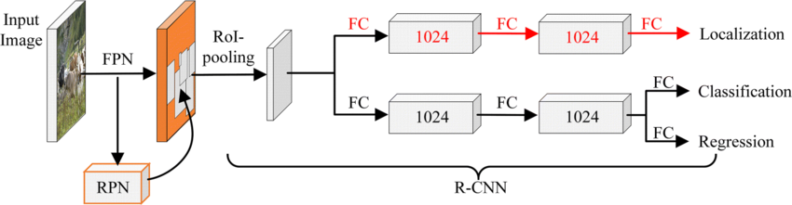
3. Modeling
Model Selection: Faster R-CNN ResNet-50 FPN
Model Type: Faster R-CNN (Region-based Convolutional Neural Network)
Backbone Network: ResNet (Residual Networks)
Pre-trained Dataset: COCO (Common Objects in Context)
Reasons for Choosing Faster R-CNN with ResNet:
High Accuracy: Known for superior performance in object detection tasks.
Feature Extraction: ResNet effectively extracts high-level features due to its deep architecture and skip connections.
Pre-trained Weights: Leveraging the COCO dataset helps in transferring learned features to the corrosion detection task.

Slide 8
4. Initial Evaluation
Xxx
Verder aanvullen

Slide 9
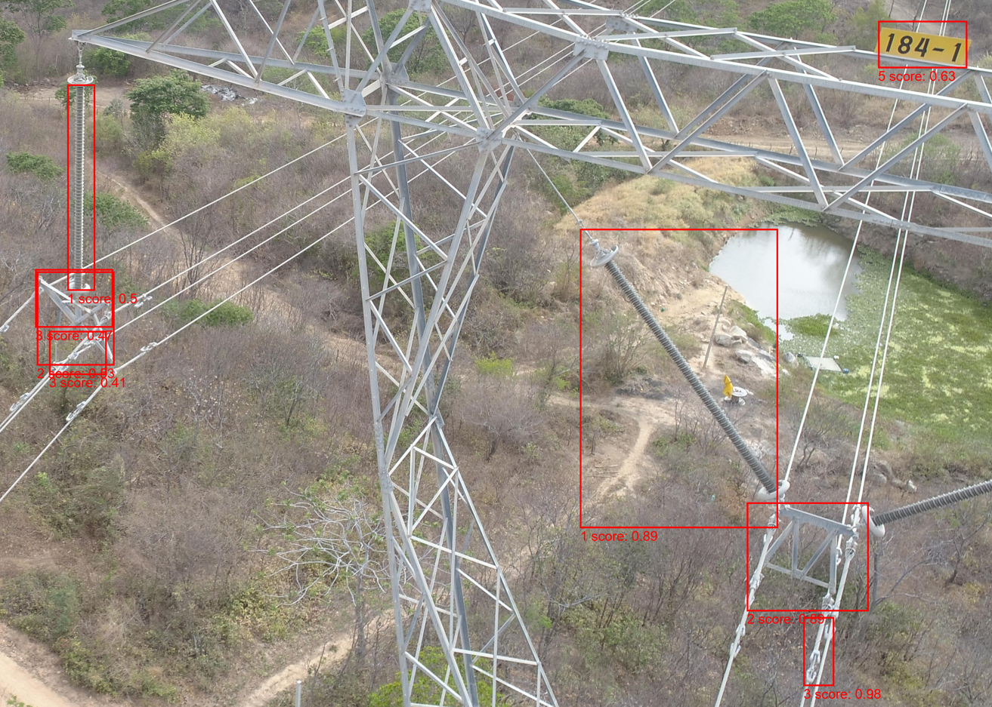
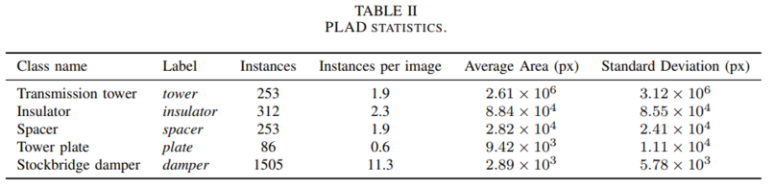
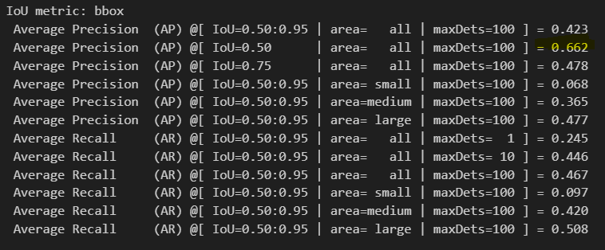
4. Evaluation with different dataset
Same ResNet model, another dataset (PLAD) with limited number of images
Component detection instead of rust detection Gave good results ! IoU
So, our ResNet model worked
https://github.com/andreluizbvs/PLAD?tab=readme-ov-file

Slide 10
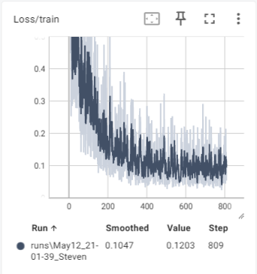
4. Final Evaluation
Xxx
Verder aanvullen

Slide 11
alternative models
OWLv2
Model Type: OWLv2
Architecture: Transformer-based backbone
Zero-shot text-conditioned object detection model
Multi-modal backbone: uses CLIP (Contrastive Language-Image Pre-training) with a ViT-like Transformer for visual features and a causal language model for text features
Key features:
Can detect objects in images without manually annotated bounding boxes
Can use text queries to detect specific objects
GPT4o
Multimodal AI model that can comprehend text, image, video, and audio inputs
Advanced image recognition capabilities enable object detection

Slide 12
alternative models
SAM
Classifier
Verder aanvullen

Slide 13
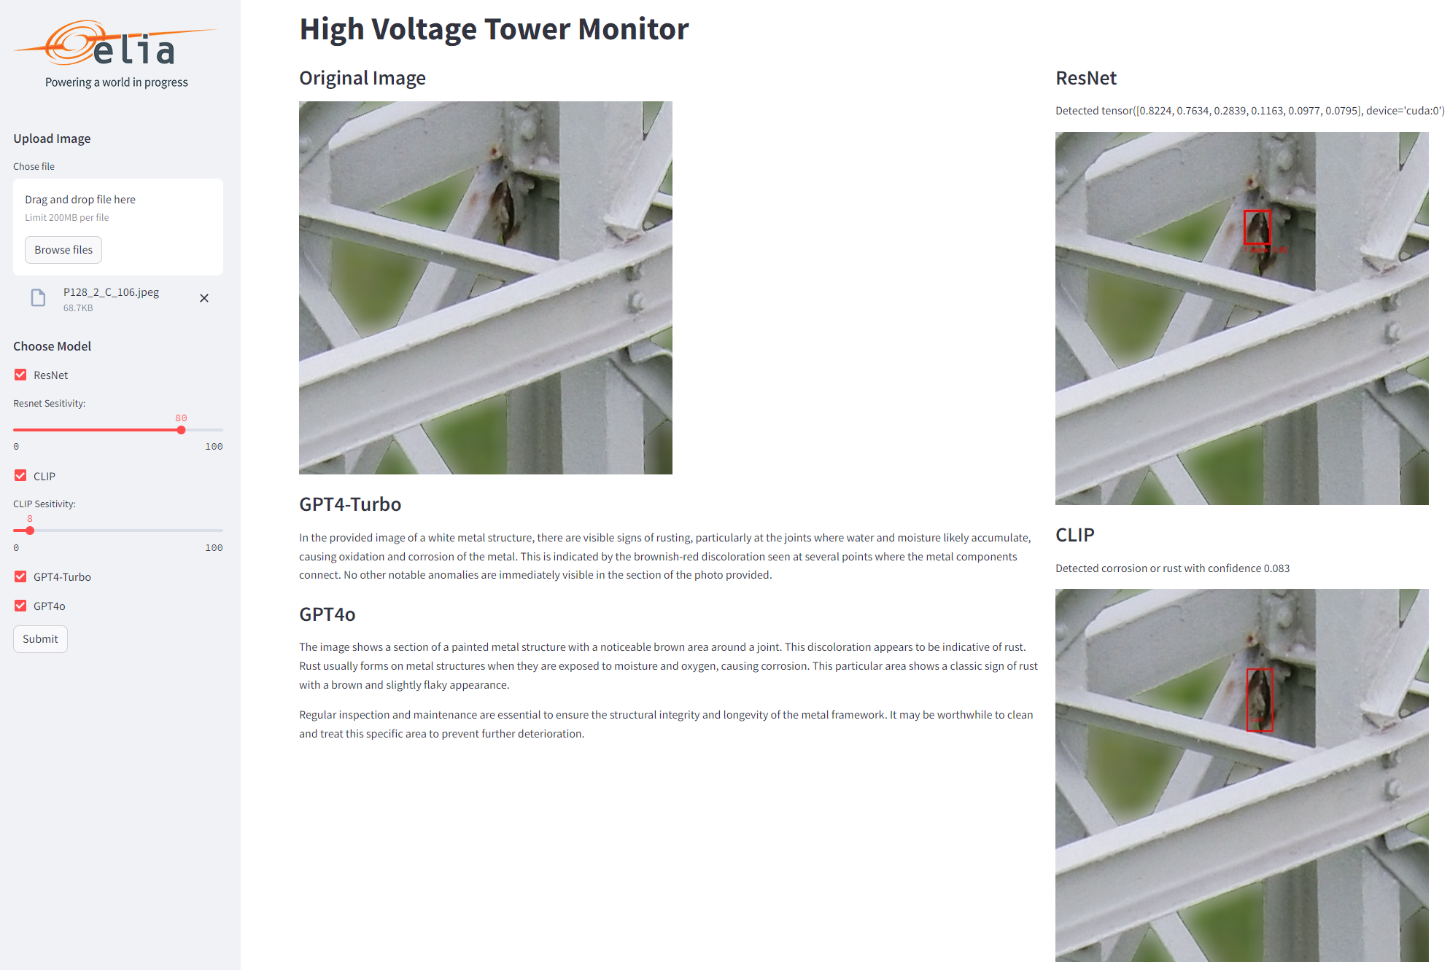
5. Demo

Slide 14
Lessons LEarned
Data quality is everything, garbage in is garbage out
Bounding boxes need to be precise and accurate
Once you have a good model, it can be trained on several datasets
There are many studies / papers on internet on similar subjects

Slide 15
Next Steps
Further fine-tuning and hyperparameter optimization.
Integration with maintenance decision support systems.
Continuous improvement based on feedback and additional data.
Use of a segmentation model. Drawback: labeling is labor intensive

Slide 16
Literature Study
Verder aanvullen

Slide 17

?

